Slide 1
Procedural Statements
Verilog provides procedural statements (also called sequential statements). Whereas concurrent statements are executed in parallel, procedural statements are evaluated in the order in which they appear in the code. Verilog syntax requires that procedural statements be contained inside an always block.

Slide 2
The Conditional Operator
conditional_expression ? true_expression : false_expression
If the conditional expression evaluates to 1 (true), then the value of true_expression is chosen; otherwise, the value of false_expression is chosen.
For example, the statement A= (B < C) ? (D + 5) : (D + 2);
means that if B is less than C, the value of A will be D + 5 or else A will have the value D+2.
Parentheses are not necessary. The conditional operator can be used both in continuous assignment statements and in procedural statements inside an always block.

Slide 3
module mux2to1 (w0, w1, s, f);
input w0, w1, s;
output f;
assign f = s ? w1 : w0;
endmodule
module mux2to1 (w0, w1, s, f);
input w0, w1, s;
output f;
reg f;
always @(w0 or w1 or s)
f = s ? w1 : w0;
endmodule

Slide 4
module mux4to1 (w0, w1, w2, w3, S, f);
input w0, w1, w2, w3;
input [1:0] S;
output f;
assign f = S[1] ? (S[0] ? w3 : w2) : (S[0] ? w1 : w0);
endmodule

Slide 5
The If-Else Statement
if-else statement has the syntax
if (conditional_expression) statement;
else statement;
If the expression is evaluated to true then the first statement (or a block of statements delineated by begin and end keywords) is executed or else the second statement (or a block of statements) is
executed.

Slide 6
module mux2to1 (w0, w1, s, f);
input w0, w1, s;
output f;
reg f;
always @(w0 or w1 or s)
if (s == 0)
f = w0;
else
f = w1;
endmodule

Slide 7
module mux4to1 (w0, w1, w2, w3, S, f);
input w0, w1, w2, w3;
input [1:0] S;
output f;
reg f;
always @(w0 or w1 or w2 or w3 or S)
if (S == 2’b00)
f = w0;
else if (S == 2’b01)
f = w1;
else if (S == 2’b10)
f = w2;
else if (S == 2’b11)
f = w3;
endmodule

Slide 8
module mux4to1 (W, S, f);
input [0:3] W;
input [1:0] S;
output f;
reg f;
always @(W or S)
if (S == 0)
f = W[0];
else if (S == 1)
f = W[1];
else if (S == 2)
f = W[2];
else if (S == 3)
f = W[3];
endmodule

Slide 9
module mux16to1 (W, S16, f);
input [0:15] W;
input [3:0] S16;
output f;
wire [0:3] M;
mux4to1 Mux1 (W[0:3], S16[1:0], M[0]);
mux4to1 Mux2 (W[4:7], S16[1:0], M[1]);
mux4to1 Mux3 (W[8:11], S16[1:0], M[2]);
mux4to1 Mux4 (W[12:15], S16[1:0], M[3]);
mux4to1 Mux5 (M[0:3], S16[3:2], f);
endmodule

Slide 10
The Case Statement
case (expression)
alternative1: statement;
alternative2: statement;
·
·
·
alternativej: statement;
[default: statement;]
endcase
The controlling expression and each alternative are compared bit by bit. When there is one or more matching alternative, the statement(s) associated with the first match (only)
is executed. When the specified alternatives do not cover all possible valuations of the controlling expression, the optional default clause should be included.

Slide 11
module mux4to1 (W, S, f);
input [0:3] W;
input [1:0] S;
output f;
reg f;
always @(W or S)
case (S)
0: f = W[0];
1: f = W[1];
2: f = W[2];
3: f = W[3];
endcase
endmodule
The four values that the select vector S can have are given as decimal numbers, but they could also be given as binary numbers.

Slide 12
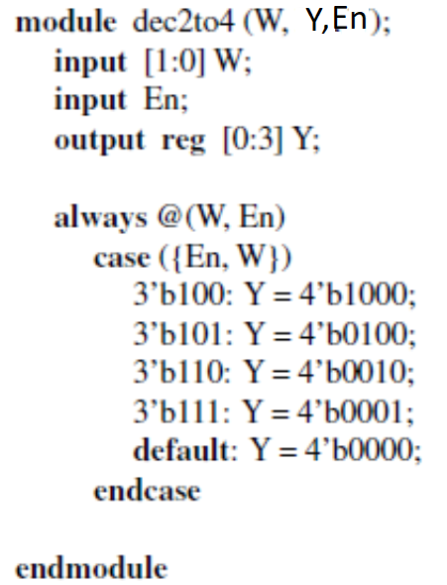
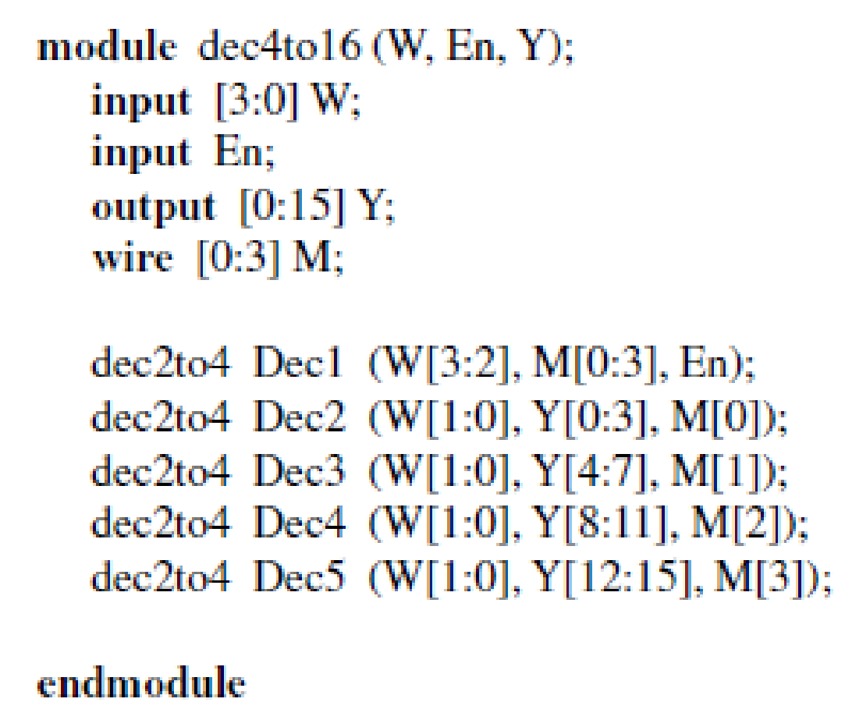

Slide 13
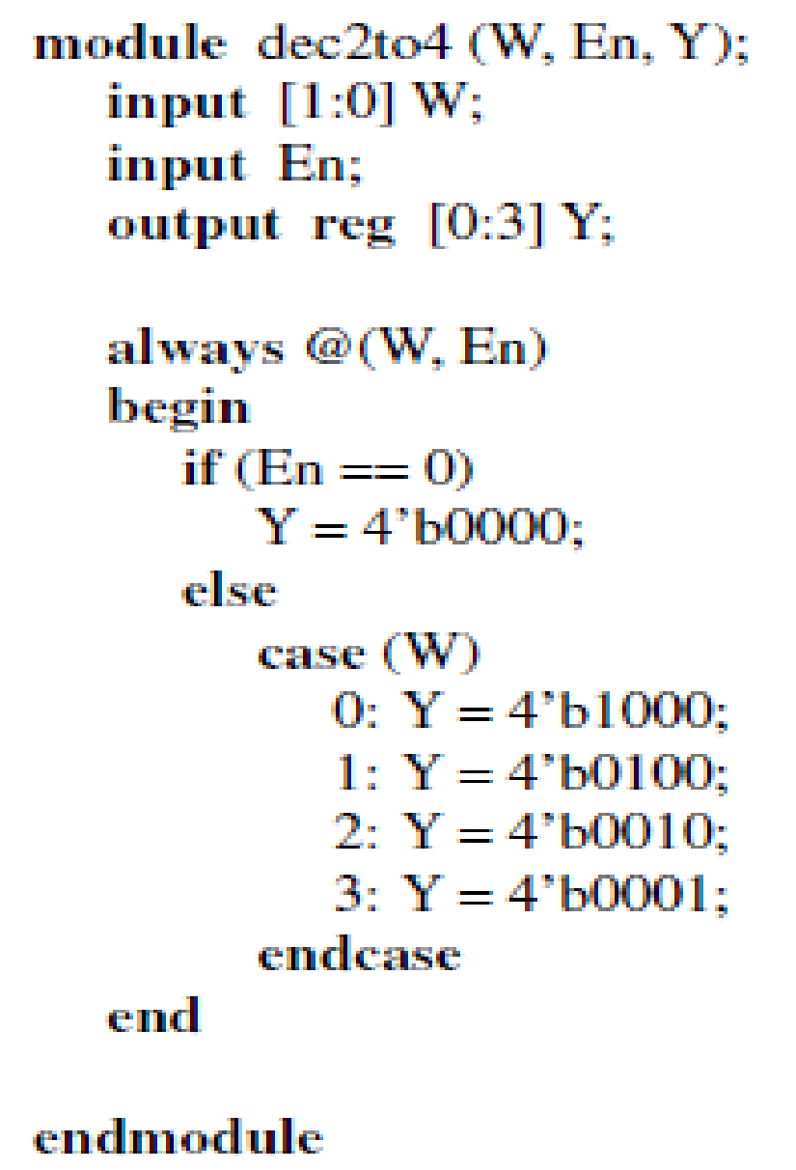

Slide 14
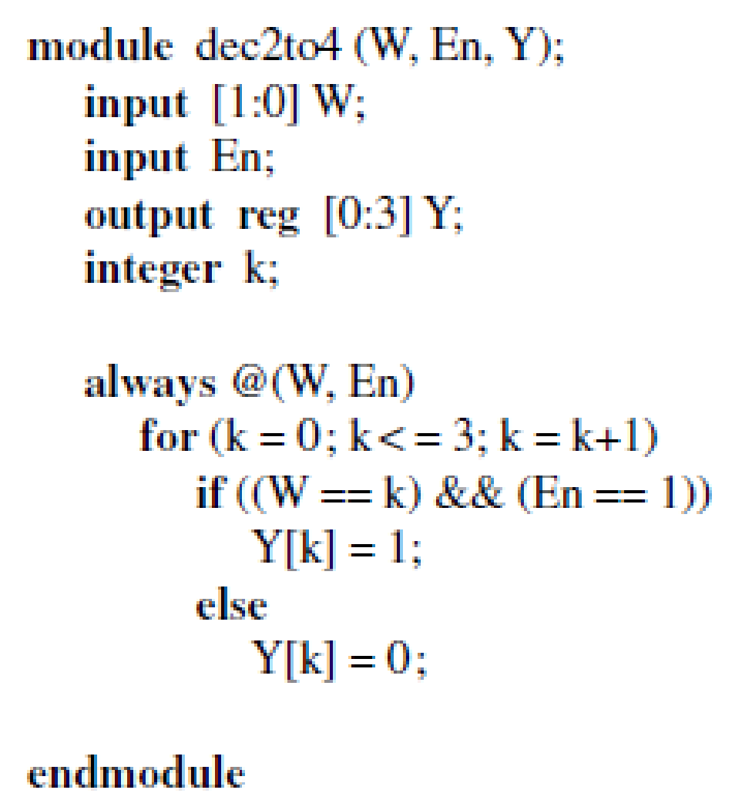

Slide 15
The Casex and Casez Statements
Verilog provides two variants of the case statement that treat the z and x values in a different way. The casez statement treats all z values in the case alternatives and the controlling expression as don’t cares. The casex statement treats all z and x values as don’t cares.

Slide 16
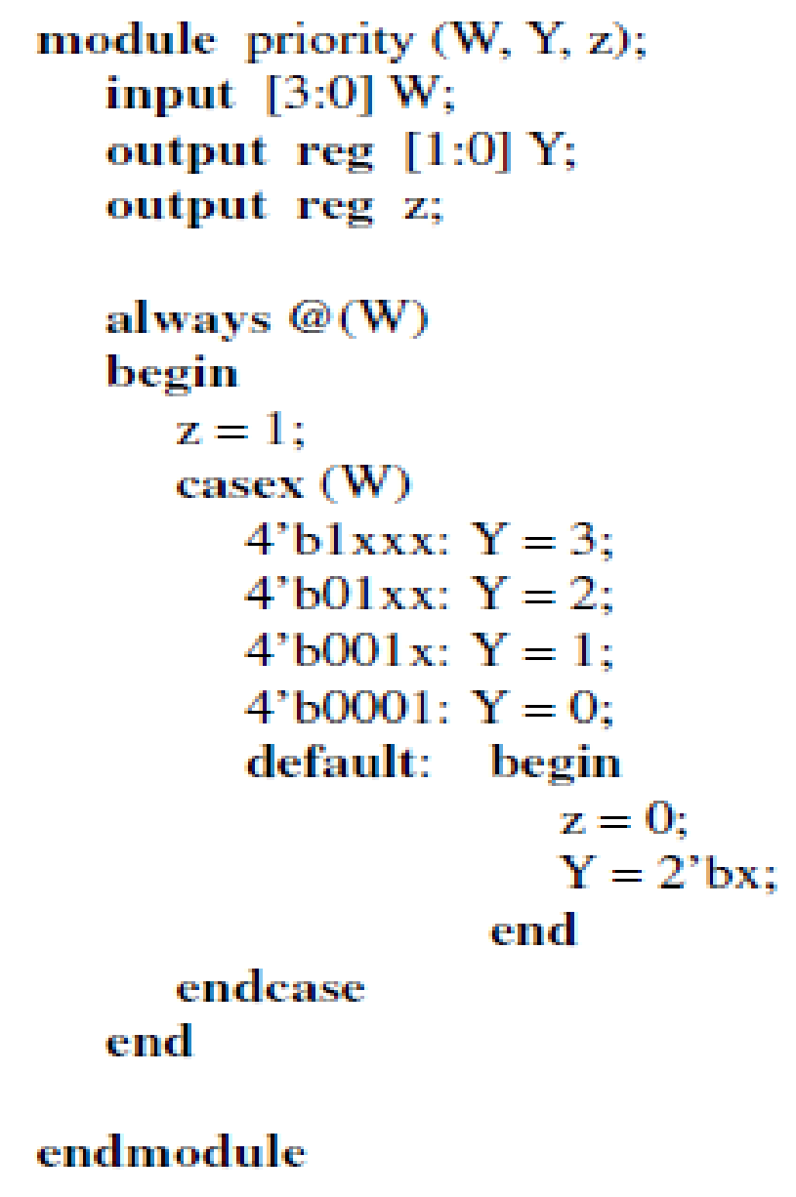

Slide 17
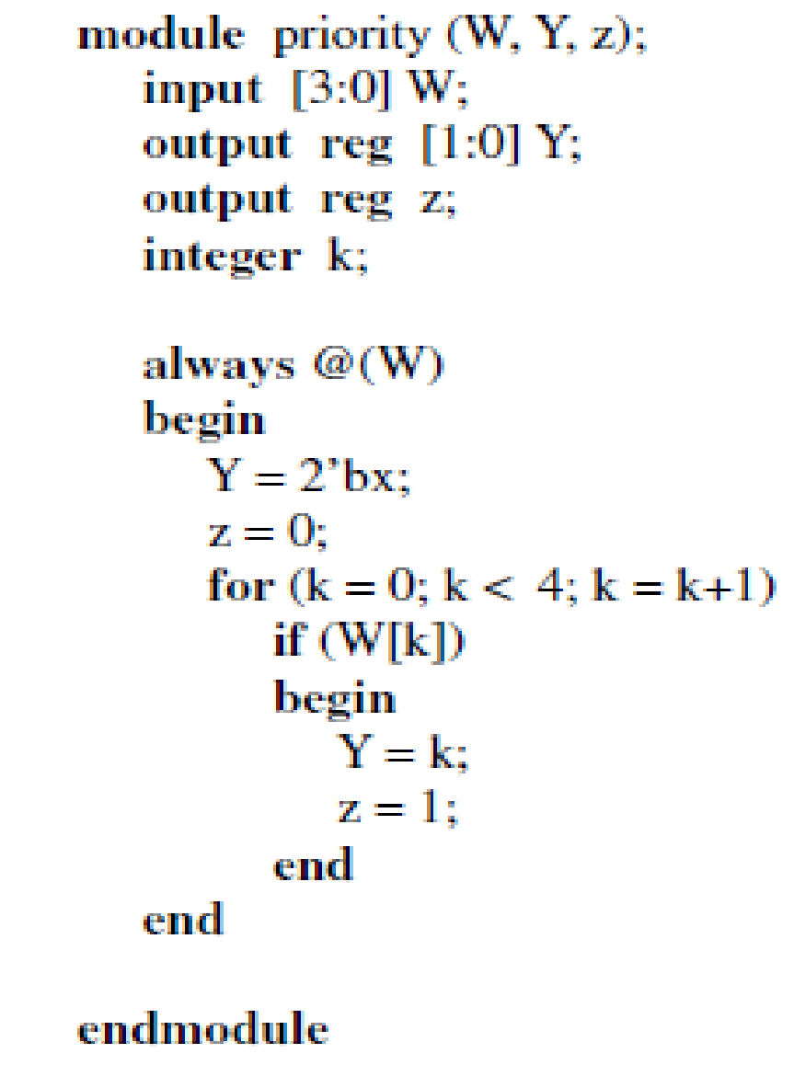

Slide 18
module mux16to1 (W, S16, f);
input [0:15] W;
input [3:0] S16;
output f;
reg f;
// Function that specifies a 4-to-1 multiplexer
function mux4to1;
input [0:3] X;
input [1:0] S4;
case (S4)
0: mux4to1 = X[0];
1: mux4to1 = X[1];
2: mux4to1 = X[2];
3: mux4to1 = X[3];
endcase
endfunction
always @(W or S16)
case (S16[3:2])
0: f = mux4to1 (W[0:3], S16[1:0]);
1: f = mux4to1 (W[4:7], S16[1:0]);
2: f = mux4to1 (W[8:11], S16[1:0]);
3: f = mux4to1 (W[12:15], S16[1:0]);
endcase
endmodule
Verilog functions can be used to modularize large designs and make the Verilog code easier to understand.
A function is declared by the keyword function and it comprises a block of statements that ends with the keyword endfunction.
The function must have at least one input and it returns a single value that is placed where the function is invoked.

Slide 19
Verilog Operators
Bitwise Operators
Bitwise operators operate on individual bits of operands. The ∼ operator forms the 1’s complement of the operand such that the statement C = ∼A;
produces the result c2 = a2’, c1 = a1’, and c0 = a0’, where ai and ci are the bits of the vectors A and C.
Other bitwise operators operate on pairs of bits. The statement
C =A& B;
generates c2 = a2&b2, c1 = a1&b1, and c0 = a0&b0.

Slide 20
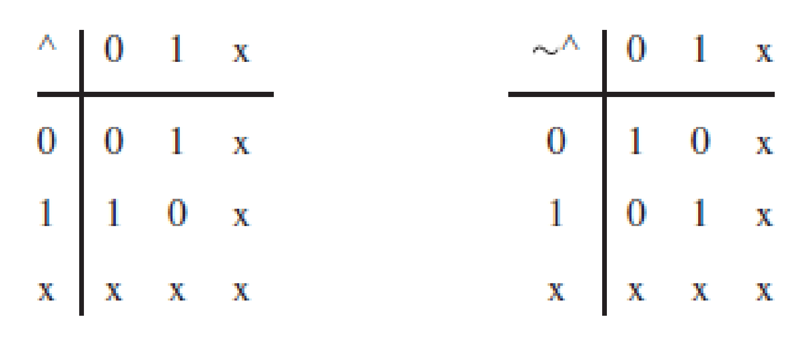
A scalar function may be assigned a value as a result of a bitwise operation on two vector operands. In this case, it is only the least-significant bits of the operands that are involved in the operation. Hence the statement f =A^B; yields f = a0 ⊕ b0.
The bitwise operations may involve operands that include the unknown logic value x.
if P = 4’b101x and Q = 4’b1001, then P& Q = 4’b100x while P | Q = 4’b1011.

Slide 21
Logical Operators
The ! operator has the same effect on a scalar operand as the ∼ operator. Thus, f = !w = ∼w.
But the effect on a vector operand is different, namely if f = !A;
then f = (a2 + a1 + a0)’.
The && operator implements the AND operation such that
f =A&& B; produces f = (a2 + a1 + a0)&(b2 + b1 + b0). Similarly, using the || operator in f =A|| B;
gives f = (a2 + a1 + a0) | (b2 + b1 + b0).

Slide 22
Reduction Operators
The reduction operators perform an operation on the bits of a single vector operand and produce a one-bit result. Using the & operator in
f = &A; produces f = a2&a1&a0.
Arithmetic Operators
C =A+ B; puts the three-bit sum of A plus B into C.
The operation C = −A; places the 2’s complement of A into C.
The addition, subtraction, and multiplication operations are supported by most CAD synthesis tools. However, the division operation is often not supported. When the Verilog compiler encounters an arithmetic operator, it usually synthesizes it by using an appropriate module from a library.

Slide 23
Relational Operators
The relational operators are typically used as conditions in if-else and for statements.
These operators function in the same way as the corresponding operators in the C programming language. An expression that uses the relational operators returns the value 1 if it is evaluated as true, and the value 0 if evaluated as false. If there are any x (unknown) or z
bits in the operands, then the expression takes the value x.

Slide 24
module compare (A, B, AeqB, AgtB, AltB);
input [3:0] A, B;
output AeqB, AgtB, AltB;
reg AeqB, AgtB, AltB;
always @(A or B)
begin
AeqB = 0;
AgtB = 0;
AltB = 0;
if (A == B)
AeqB = 1;
else if (A > B)
AgtB = 1;
else
AltB = 1;
end
endmodule

Slide 25
Equality Operators
The expression (A == B) is evaluated as true if A is equal to B and false otherwise.
The != operator has the opposite effect. The result is ambiguous (x) if either operand contains x or z values.
Shift Operators
A vector operand can be shifted to the right or left by a number of bits specified as a constant. When bits are shifted, the vacant bit positions are filled with 0s. For example,
B =A<< 1; results in b2 = a1, b1 = a0, and b0 = 0. Similarly,
B =A>> 2; yields b2 = b1 = 0 and b0 = a2.

Slide 26
Concatenate Operator
This operator concatenates two or more vectors to create a larger vector. For example, D = {A, B}; defines the six-bit vector D = a2a1a0b2b1b0. Similarly, the concatenation E = {3’b111, A, 2’b00};
produces the eight-bit vector E = 111a₂a₁a₀00.
Replication Operator
This operator allows repetitive concatenation of the same vector, which is replicated the number of times indicated in the replication constant. For example, {3{A}} is equivalent to writing {A, A, A}. The specification {4{2’b10}} produces the eight-bit vector 10101010.
The replication operator may be used in conjunction with the concatenate operator. For instance, {2{A}, 3{B}} is equivalent to {A, A, B, B, B}.

